Slide 1


System Clock options
AMERICAN INTERNATIONAL UNIVERSITY – BANGLADESH (AIUB)
Where leaders are created
By Tahseen Asma Meem

Slide 2
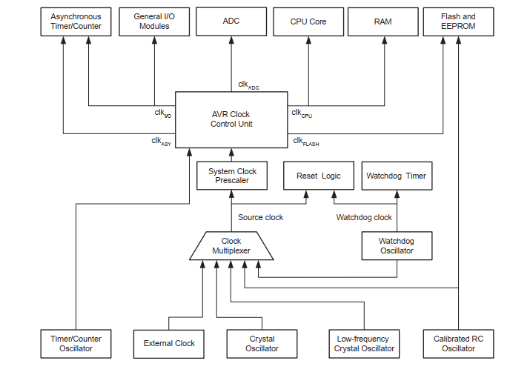
INTRODUCTION:
The block diagram represents the principal clock systems in the AVR and their distribution. All of the clocks need not be active at a given time. In order to reduce power consumption, the clocks to modules not being used can be halted by using different sleep modes.

Slide 3
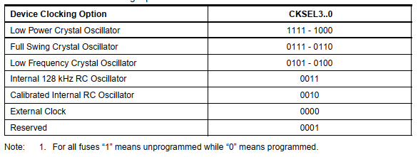
Clock sources:
The device has the following clock source options, selectable by Flash Fuse bits as shown. The clock from the selected source is input to the AVR clock generator, and routed to the appropriate modules

Slide 4
Default clock source:
The device is shipped with internal RC oscillator at 8.0MHz and with the fuse CKDIV8 programmed, resulting in 1.0MHz system clock. The startup time is set to maximum and time-out period enabled. (CKSEL = "0010", SUT = "10", CKDIV8 = "0"). The default setting ensures that all users can make their desired clock source setting using any available programming interface.

Slide 5
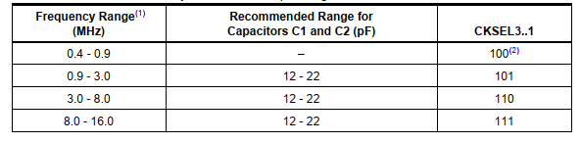
Low Power Crystal Oscillator :
Pins XTAL1 and XTAL2 are input and output, respectively, of an inverting amplifier which can be configured for use as an On-chip Oscillator
Notes:
Either a quartz crystal or a ceramic resonator may be used. This Crystal Oscillator is a low power oscillator, with reduced voltage swing on the XTAL2 output.
Drawback: It gives the lowest power consumption, but is not capable of driving other clock inputs, and may be more susceptible to noise in noisy environments.
C1 and C2 should always be equal for both crystals and resonators. The optimal value of the capacitors depends on the crystal or resonator in use, the amount of stray capacitance, and the electromagnetic noise of the environment. Some initial guidelines for choosing capacitors for use with crystals are given in Table below.. The Low Power Oscillator can operate in three different modes, each optimized for a specific frequency range. The operating mode is selected by the fuses CKSEL3..1

Slide 6

Full swing Crystal Oscillator :
This Crystal Oscillator is a full swing oscillator, with rail-to-rail swing on the XTAL2 output. This is useful for driving other clock inputs and in noisy environments.
Notes:
The current consumption is higher than the ”Low Power Crystal Oscillator” . The Full Swing Crystal Oscillator will only operate for VCC = 2.7 - 5.5 volts.
C1 and C2 should always be equal for both crystals and resonators. The optimal value of the capacitors depends on the crystal or resonator in use, the amount of stray capacitance, and the electromagnetic noise of the environment. Some initial guidelines for choosing capacitors for use with crystals are given in table below. The operating mode is selected by the fuses CKSEL3..1

Slide 7
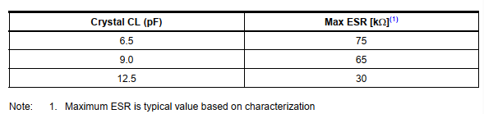
Low frequency Crystal Oscillator :
The Low-frequency Crystal Oscillator is optimized for use with a 32.768 kHz watch crystal. When selecting crystals, load capacitance and crystal’s Equivalent Series Resistance, ESR must be taken into consideration. Both values are specified by the crystal vendor.
Notes:
ATmega48P/88P/168P/328P oscillator is optimized for very low power consumption, and thus when selecting crystals, for maximum ESR recommendations on 6.5 pF, 9.0 pF and 12.5 pF crystals

Slide 8

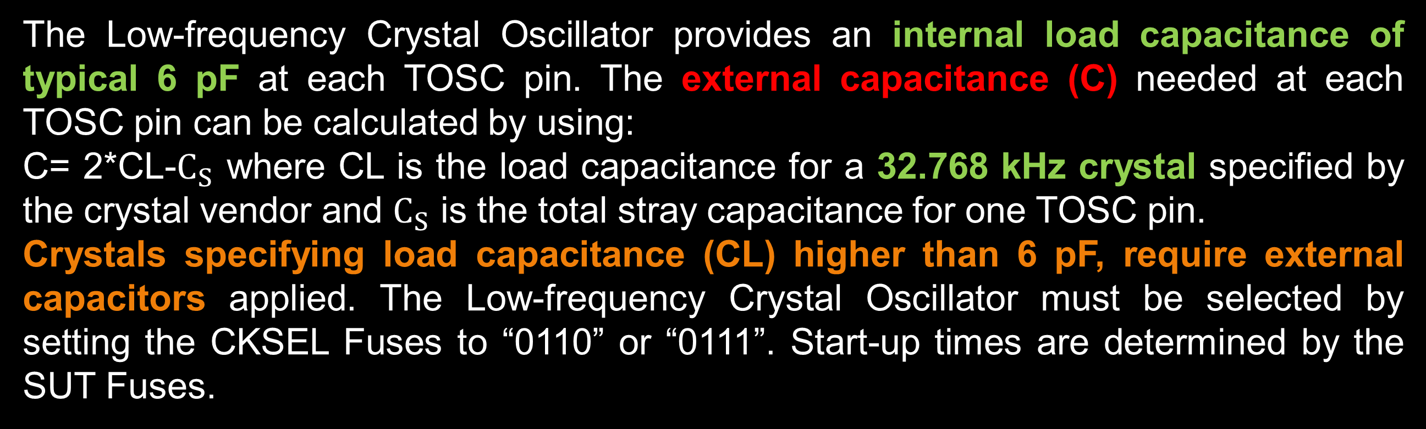
Low frequency Crystal Oscillator :
The Low-frequency Crystal Oscillator provides an internal load capacitance of typical 6 pF at each TOSC pin. The external capacitance (C) needed at each TOSC pin can be calculated by using:
C= 2*CL-$C_{S}$ where CL is the load capacitance for a 32.768 kHz crystal specified by the crystal vendor and $C_{S}$ is the total stray capacitance for one TOSC pin.
Crystals specifying load capacitance (CL) higher than 6 pF, require external capacitors applied. The Low-frequency Crystal Oscillator must be selected by setting the CKSEL Fuses to “0110” or “0111”. Start-up times are determined by the SUT Fuses.

Slide 9
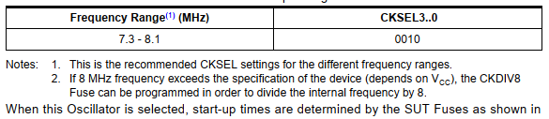
Calibrated internal RC Oscillator :
By default, the Internal RC Oscillator provides an approximate 8.0 MHz clock. Though voltage and temperature dependent, this clock can be very accurately calibrated by the user. The device is shipped with the CKDIV8 Fuse programmed. This clock may be selected as the system clock by programming the CKSEL Fuses .
If selected, it will operate with no external components. During reset, hardware loads the pre-programmed calibration value into the OSCCAL Register and thereby automatically calibrates the RC Oscillator.

Slide 10
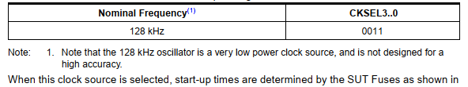
128 kHz internal Oscillator :
The 128 kHz internal Oscillator is a low power Oscillator providing a clock of 128 kHz. The frequency is nominal at 3V and 25°C. This clock may be select as the system clock by programming the CKSEL Fuses to “11” .

Slide 11
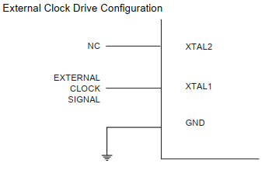

External clock:
To drive the device from an external clock source, XTAL1 should be driven as shown
To run the device on an external clock, the CKSEL Fuses must be programmed to “0000”

Slide 12
System clock prescalar:
The ATmega48P/88P/168P/328P has a system clock prescaler, and the system clock can be divided by setting the ”CLKPR – Clock Prescale Register”.
This feature can be used to decrease the system clock frequency and the power consumption when the requirement for processing power is low. This can be used with all clock source options, and it will affect the clock frequency of the CPU and all synchronous peripherals.
Notes:
ATmega48P/88P/168P/328P uses the same crystal oscillator for Low-frequency Oscillator and Timer/Counter Oscillator.
ATmega48P/88P/168P/328P share the Timer/Counter Oscillator Pins (TOSC1 and TOSC2) with XTAL1 and XTAL2.
When using the Timer/Counter Oscillator, the system clock needs to be four times the oscillator frequency. Due to this and the pin sharing, the Timer/Counter Oscillator can only be used when the Calibrated Internal RC Oscillator is selected as system clock source. Applying an external clock source to TOSC1 can be done if EXTCLK in the ASSR Register is written to logic one.

Slide 13

Register description:
• CLKPR-Clock Pre-scale Register
• Bit 7 – CLKPCE: Clock Prescaler Change Enable
The CLKPCE bit must be written to logic one to enable change of the CLKPS bits. The CLKPCE bit is only updated when the other bits in CLKPR are simultaneously written to zero. CLKPCE is cleared by hardware four cycles after it is written or when CLKPS bits are written. Rewriting the CLKPCE bit within this time-out period does neither extend the time-out period, nor clear the CLKPCE bit.

Slide 14
Register description:
• CLKPR-Clock Prescale Register
• Bits 3..0 – CLKPS3..0: Clock Prescaler Select Bits 3 - 0
These bits define the division factor between the selected clock source and the internal system clock. These bits can be written run-time to vary the clock frequency to suit the application requirements. As the divider divides the master clock input to the MCU, the speed of all synchronous peripherals is reduced when a division factor is used.
Notes:
The CKDIV8 Fuse determines the initial value of the CLKPS bits.
If CKDIV8 is unprogrammed, the CLKPS bits will be reset to “0000”.
If CKDIV8 is programmed, CLKPS bits are reset to “0011”, giving a division factor of 8 at start up. This feature should be used if the selected clock source has a higher frequency than the maximum frequency of the device at the present operating conditions.
Any value can be written to the CLKPS bits regardless of the CKDIV8 Fuse setting. The Application software must ensure that a sufficient division factor is chosen if the selected clock source has a higher frequency than the maximum frequency of the device at the present operating conditions. The device is shipped with the CKDIV8 Fuse programmed.

Slide 15
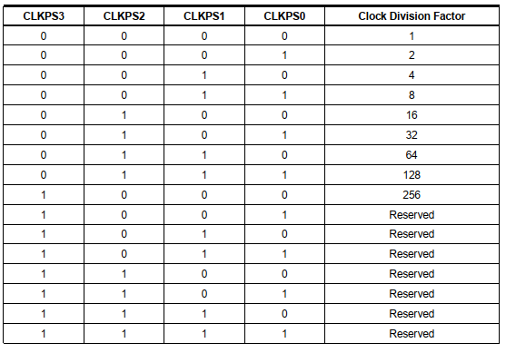
Register description: clock prescaler select
Notes:
The CKDIV8 Fuse determines the initial value of the CLKPS bits.
If CKDIV8 is unprogrammed, the CLKPS bits will be reset to “0000”.
If CKDIV8 is programmed, CLKPS bits are reset to “0011”, giving a division factor of 8 at start up. This feature should be used if the selected clock source has a higher frequency than the maximum frequency of the device at the present operating conditions.
Any value can be written to the CLKPS bits regardless of the CKDIV8 Fuse setting. The Application software must ensure that a sufficient division factor is chosen if the selected clock source has a higher frequency than the maximum frequency of the device at the present operating conditions. The device is shipped with the CKDIV8 Fuse programmed.

Slide 16
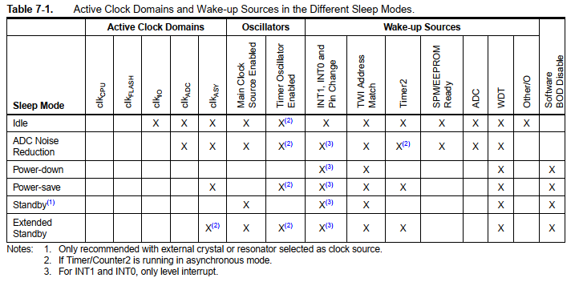
Power management &sleep modes:
Sleep modes enable the application to shut down unused modules in the MCU, thereby saving power. The AVR provides various sleep modes allowing the user to tailor the power consumption to the application’s requirements.

Slide 17

Register description:
SMCR – Sleep Mode Control Register
The Sleep Mode Control Register contains control bits for power management.
Notes:
To enter any of the six sleep modes, the SE bit in SMCR must be written to logic one and a SLEEP instruction must be executed. The SM2, SM1, and SM0 bits in the SMCR Register select which sleep mode (Idle, ADC Noise Reduction, Power-down, Power-save, Standby, or Extended Standby) will be activated by the SLEEP instruction. If an enabled interrupt occurs while the MCU is in a sleep mode, the MCU wakes up. The MCU is then halted for four cycles in addition to the start-up time, executes the interrupt routine, and resumes execution from the instruction following SLEEP. The contents of the Register File and SRAM are unaltered when the device wakes up from sleep. If a reset occurs during sleep mode, the MCU wakes up and executes from the Reset Vector. • Bits 7..4 Res: Reserved Bits
These bits are unused bits in the ATmega48P/88P/168P/328P, and will always read as zero.
• Bits 3..1 – SM2..0: Sleep Mode Select Bits 2, 1, and 0
These bits select between the five available sleep modes as shown in Table 7-2.
• Bit 0 – SE: Sleep Enable
The SE bit must be written to logic one to make the MCU enter the sleep mode when the SLEEP
instruction is executed. To avoid the MCU entering the sleep mode unless it is the programmer’s
purpose, it is recommended to write the Sleep Enable (SE) bit to one just before the execution of
the SLEEP instruction and to clear it immediately after waking up

Slide 18
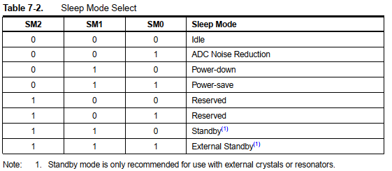

Slide 19

PRR-Power reduction register:
• Bit 7 - PRTWI: Power Reduction TWI • Bit 6 - PRTIM2: Power Reduction Timer/Counter2 • Bit 5 - PRTIM0: Power Reduction Timer/Counter0
Bit 4 - Res: Reserved bit
Bit 3 - PRTIM1: Power Reduction Timer/Counter1
Bit 2 - PRSPI: Power Reduction Serial Peripheral Interface
Bit 1 - PRUSART0: Power Reduction USART0Bit 0 - PRADC: Power Reduction ADC
Notes:
Bit 7 - PRTWI: Power Reduction TWI Writing a logic one to this bit shuts down the TWI by stopping the clock to the module. When waking up the TWI again, the TWI should be re initialized to ensure proper operation. • Bit 6 - PRTIM2: Power Reduction Timer/Counter2 Writing a logic one to this bit shuts down the Timer/Counter2 module in synchronous mode (AS2 is 0). When the Timer/Counter2 is enabled, operation will continue like before the shutdown. • Bit 5 - PRTIM0: Power Reduction Timer/Counter0 Writing a logic one to this bit shuts down the Timer/Counter0 module. When the Timer/Counter0 is enabled, operation will continue like before the shutdown.
Bit 4 - Res: Reserved bit
This bit is reserved in ATmega48P/88P/168P/328P and will always read as zero.
• Bit 3 - PRTIM1: Power Reduction Timer/Counter1
Writing a logic one to this bit shuts down the Timer/Counter1 module. When the Timer/Counter1 is enabled, operation will continue like before the shutdown.
• Bit 2 - PRSPI: Power Reduction Serial Peripheral Interface
If using debugWIRE On-chip Debug System, this bit should not be written to one.
Writing a logic one to this bit shuts down the Serial Peripheral Interface by stopping the clock to the module. When waking up the SPI again, the SPI should be re initialized to ensure proper operation.
• Bit 1 - PRUSART0: Power Reduction USART0
Writing a logic one to this bit shuts down the USART by stopping the clock to the module. When waking up the USART again, the USART should be re initialized to ensure proper operation.
• Bit 0 - PRADC: Power Reduction ADC
Writing a logic one to this bit shuts down the ADC. The ADC must be disabled before shut down. The analog comparator cannot use the ADC input MUX when the ADC is shut down .

Slide 20
Thanks for attending….
?

